Slide 1

DIGITAL SHIELD
Protecting Women in African Digital Spaces
Presented by Eng. Stephen Odhiambo, Kenyan AI & Software Engineer

Slide 2

The Crisis: Women Under Digital Attack
Image-Based Abuse
Cyberstalking
Victims suffer from non-consensual sharing of images, leading to emotional distress and reputational harm.
Perpetrators engage in monitoring and tracking, creating fear and anxiety for targeted individuals online.
Online Harassment
Emotional Impact
Women face threats and coordinated attacks, often feeling unsafe in digital spaces and social media.
The psychological toll of these attacks often results in anxiety, depression, and social withdrawal among victims.

Slide 3
The Perfect Storm
Smartphone Adoption
Social Media Surge
Support Tool Gap
Over 800 million users across Africa are now accessing digital platforms, increasing vulnerability to online abuse.
The COVID-19 pandemic has led to unprecedented growth in social media usage, amplifying risks for women.
Existing support tools lack cultural sensitivity, making it difficult for women to seek appropriate help.

Slide 4
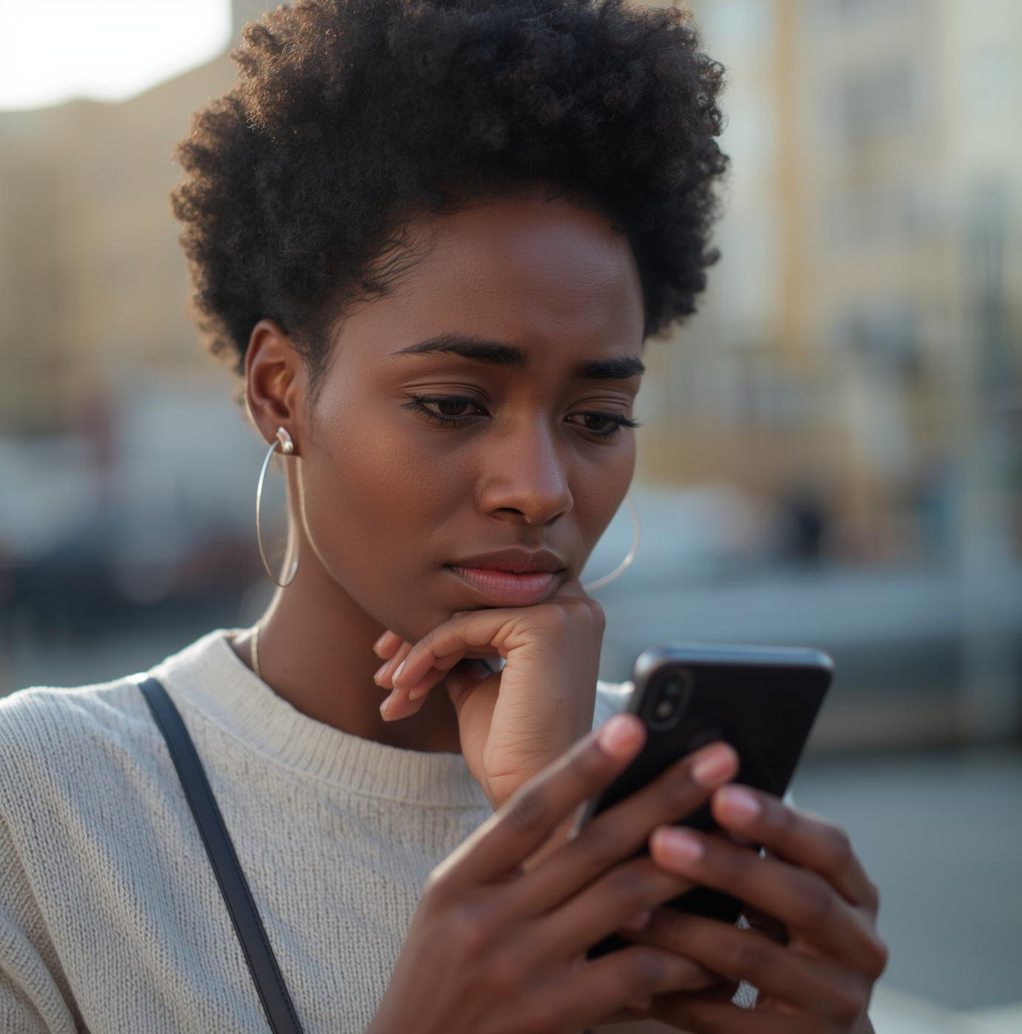

Current Options
Limited Support Available

Slide 5
Digital Shield Features
Emergency Triage
Safety Checklists
Zero Data
Our chatbot provides step-by-step crisis guidance, ensuring users receive immediate and appropriate support.
Comprehensive platform-specific security guidelines help users protect themselves on social media and messaging apps.
We guarantee complete privacy with no data collection, ensuring users remain anonymous and secure.

Slide 6



Three Steps to Safety
01
03
02
Choose
Receive
Select your situation from provided options.
Get an action plan for immediate protection.
Get
Receive personalized guidance through conversational support.

Slide 7



Technology Stack Overview
Core Technology Features
Our technology foundation emphasizes security and speed, utilizing modern frameworks for efficient performance and privacy protection.

Slide 8

What Sets Us Apart
True Privacy
Crisis-Appropriate
Our platform ensures zero data collection, guaranteeing complete anonymity for all users in crisis.
The design prioritizes calmness and reassurance, providing a supportive environment during distressing situations.
African Context
Production-Ready
We are tailored to local needs, collaborating with Kenyan helplines and organizations for effective support.
Digital Shield can be deployed swiftly, enabling rapid response for users without lengthy implementations.

Slide 9

Target Market
Our primary audience is African women and girls aged 16-35, representing over 250 million potential users across Kenya, Nigeria, South Africa, Uganda, and Ghana. We also engage with GBV support organizations and digital rights NGOs to broaden our impact.

Slide 10



Sustainable Partnerships
Building a Better Future
Strategic partnerships enable impactful interventions and sustainable funding for Digital Shield's mission to protect women.

Slide 11
Timeline of Events
MVP
Initial launch with core features.
Phase 2
Multi-language support added soon.
Phase 3
Expansion to more platforms begins.
Phase 4
Full deployment across Africa planned.

Slide 12
100,000
Users Helped in Year 1
Our goal is to support 100,000 women in navigating digital threats, providing immediate assistance and ensuring their online safety and privacy.

Slide 13

Team & Partnerships

Slide 14

Join Us
Digital Shield seeks to protect African women from technology-facilitated gender-based violence. By partnering with us, you can help create a safer digital environment through comprehensive support, empowerment, and innovative technology tailored to their unique needs.
Email:stephenodhiambo008@gmail.com
stephenatito1994@gmail.com
Email:0701453230
0708931159

